Slide 1
CLASSROOM PRESENTATION
Logistic
Regression
From a linear score to a classification decision
Intuition • Sigmoid • Log Loss • Model Training • Evaluation • GridSearchCV
NO DERIVATIVES
STEP-BY-STEP EXAMPLES
Notes:
Introduce the core question: Can we predict Pass or Fail from hours studied? Explain that this lesson emphasizes understanding, not calculus.

Slide 2
FOUNDATIONS
What students will be able to do
By the end, they should understand the model—not just run the code.
Explain the need
Calculate a prediction
Explain model learning
Build and assess
Recognize binary classification and why an ordinary regression output is not a probability.
Work from z = mx + c to Sigmoid probability and then the class label.
Interpret Log Loss and describe how coefficients are adjusted to reduce it.
Train, evaluate, cross-validate and tune Logistic Regression in Scikit-learn.
LOGISTIC REGRESSION • CLASSROOM GUIDE
02
Notes:
Learning objective check: Students should distinguish predicted probability from predicted class by the end.

Slide 3
FOUNDATIONS
12 topics • one connected story
Organized into four blocks: Understand → Predict → Learn → Apply
01–02
03–06
07–08
09–12
Why classification?
How prediction works
How it learns
How we use it
Pass/Fail data
Linear Regression limitation
Linear score → Sigmoid
Threshold → Decision boundary
Log Loss
Gradient Descent intuition
Multiple features → Evaluation
Python → CV + GridSearchCV
One dataset and one set of symbols are reused through the foundational explanation.
LOGISTIC REGRESSION • CLASSROOM GUIDE
03
Notes:
Connect each block to the earlier Linear Regression and Gradient Descent sessions.

Slide 4
FOUNDATIONS
Start with a familiar problem
Can study hours help predict whether a student passes?
Study hours (X)
Result (y)
OUR QUESTION
1
0 · Fail
What happens when a new student studies 6 hours?
2
0 · Fail
3
0 · Fail
4
1 · Pass
0 = FAIL
1 = PASS
5
1 · Pass
This small dataset is illustrative; real training uses more observations and validation data.
LOGISTIC REGRESSION • CLASSROOM GUIDE
04
Notes:
Ask: What is X? What is y? How many possible outcomes are there?

Slide 5
FOUNDATIONS
Regression vs classification
Same input variable; a different type of output.
LINEAR REGRESSION
LOGISTIC REGRESSION
Question: How many marks will the student score?
Output: a continuous number, such as 72.5
Question: Will the student pass?
Output: a probability, followed by Pass or Fail
Logistic Regression is a classification algorithm despite the word “regression” in its name.
LOGISTIC REGRESSION • CLASSROOM GUIDE
05
Notes:
Ask students to classify house price, churn, marks, spam, and loan approval as regression or classification.

Slide 6
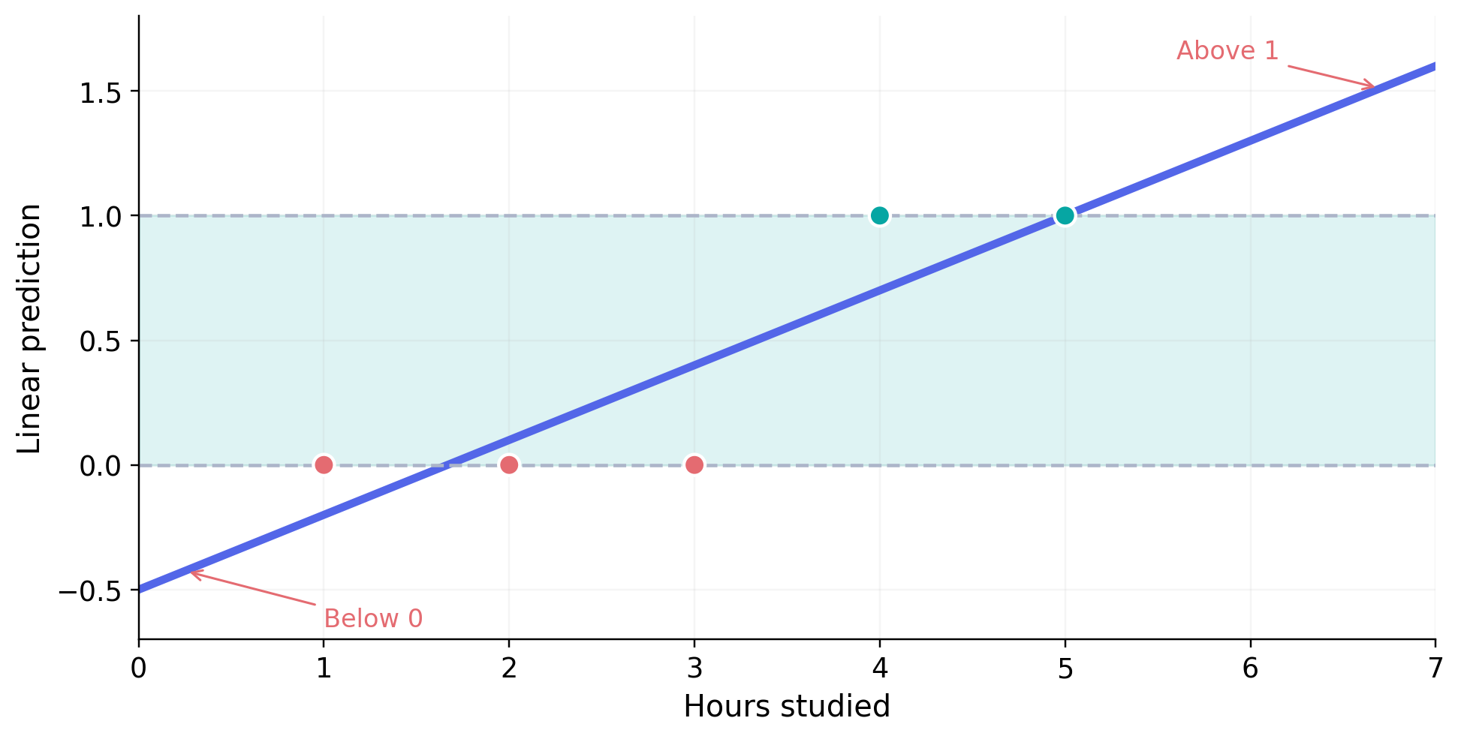
FOUNDATIONS
Why not predict binary outcomes with a line?
An ordinary linear prediction can be smaller than 0 or larger than 1.
ILLUSTRATIVE LINE
ŷ = 0.3x − 0.5
x = 1 → −0.2
x = 6 → 1.3
A probability must stay within 0 and 1.
Ordinary Linear Regression can be thresholded, but it is not designed to model valid binary probabilities.
LOGISTIC REGRESSION • CLASSROOM GUIDE
06
Notes:
Prompt: What would a 130% probability mean? Avoid suggesting thresholding Linear Regression is mathematically impossible—explain why Logistic Regression is a better probability model.

Slide 7
PREDICTION
The full prediction idea—in one view
Logistic Regression first predicts a probability, then a class.
INPUT
LINEAR SCORE
SIGMOID
THRESHOLD
CLASS
x = 5 hours
z = mx + c
p = 0.8176
p ≥ 0.5
Pass (1)
Probability ≠ predicted class
LOGISTIC REGRESSION • CLASSROOM GUIDE
07
Notes:
Repeat the flow frequently. Emphasize that the model must first output a probability and only then a class.

Slide 8
PREDICTION
Step 3 — Start with z = mx + c
The linear equation produces an intermediate score, not a probability.
WORKED EXAMPLE
Remember
z = mx + c
z = 1.5
m = 1.5 c = −6 x = 5
The score can be any real number. We still need to turn it into a valid probability.
z = (1.5 × 5) − 6 = 1.5
m = 1.5 and c = −6 are assumed for this hand calculation; they are not fitted values from the small table.
LOGISTIC REGRESSION • CLASSROOM GUIDE
08
Notes:
Ask: Is 1.5 a Pass/Fail label? Is it a probability? Answer: Neither—it is a score.

Slide 9
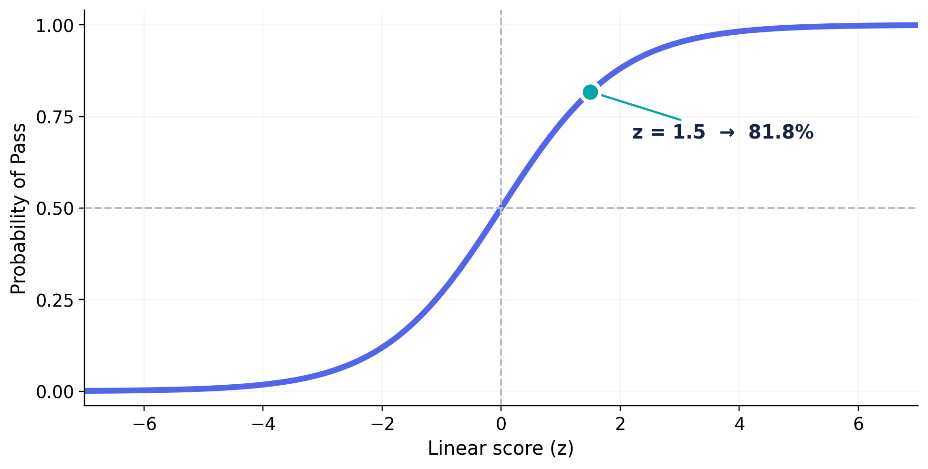
PREDICTION
Step 4 — Sigmoid makes the score a probability
It maps any value of z to a number between 0 and 1.
SIGMOID FORMULA
p = 1 / (1 + e⁻ᶻ)
z < 0 → p < 0.5
z = 0 → p = 0.5
z > 0 → p > 0.5
Here e is a mathematical constant, approximately 2.718.
LOGISTIC REGRESSION • CLASSROOM GUIDE
09
Notes:
Point out the S-shape, saturation near 0 and 1, and exactly p=.5 at z=0.

Slide 10
PREDICTION
Calculate one probability by hand
For the student who studied five hours, z = 1.5.
Linear score
Apply Sigmoid
01
02
z = 1.5
p = 1 / (1 + e⁻¹·⁵)
Evaluate exponent
Final probability
03
04
e⁻¹·⁵ ≈ 0.2231
p ≈ 0.8176 = 81.76%
Interpretation: the model estimates an 81.76% probability of the student passing.
LOGISTIC REGRESSION • CLASSROOM GUIDE
10
Notes:
Have learners compute 1/(1+e^-1.5) on a calculator; distinguish 0.818 probability from the class 1.

Slide 11
PREDICTION
The same model predicts for every student
Keep m = 1.5 and c = −6 fixed; change only the input x.
Hours (x)
Score z
P(Pass)
Class at 0.5
1
−4.5
0.011
Fail
2
−3.0
0.047
Fail
3
−1.5
0.182
Fail
4
0
0.500
Pass
5
1.5
0.818
Pass
6
3.0
0.953
Pass
QUESTION: why does 4 hours become Pass?
LOGISTIC REGRESSION • CLASSROOM GUIDE
11
Notes:
At exactly p=.5, our declared rule p>=.5 maps to class 1. Clarify that this is a chosen convention.

Slide 12
PREDICTION
Step 5 — Threshold converts probability to a class
A 0.5 threshold is common, but it can be changed.
RULE
OUR EXAMPLE
p ≥ 0.50 → Pass (1)
p = 0.8176
p < 0.50 → Fail (0)
PASS
Thresholding happens after the probability is calculated—not during the Log Loss calculation.
LOGISTIC REGRESSION • CLASSROOM GUIDE
12
Notes:
Ask: At a 0.9 threshold, would this student be predicted Pass? No, though the probability remains 0.8176.

Slide 13
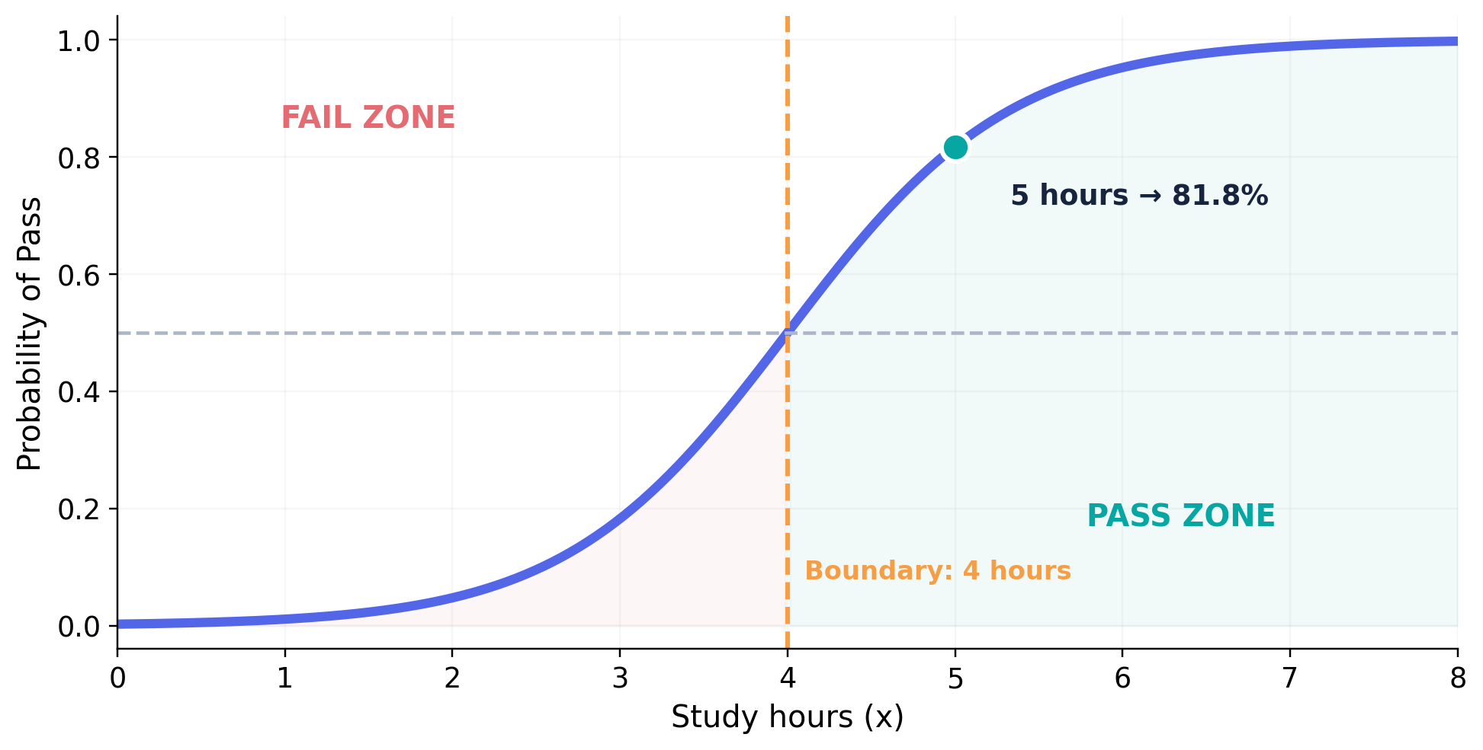
PREDICTION
Step 6 — The decision boundary
With a 0.5 threshold, the class changes where Sigmoid probability is 0.5.
CALCULATE IT
p = 0.5
z = 0
1.5x − 6 = 0
x = 4 hours
Decision boundary is a point with one feature; a line in the original feature space with two features.
LOGISTIC REGRESSION • CLASSROOM GUIDE
13
Notes:
Explain that the probability curve is smooth while the final class output jumps at the threshold.

Slide 14
PREDICTION
Quick check — predict before revealing
Use the illustrative model z = 1.5x − 6.
A student studied 3 hours.
1. What is z?
2. Is p below or above 0.5?
3. Pass or Fail?
LOGISTIC REGRESSION • CLASSROOM GUIDE
14
Notes:
Hide the right-hand side while questioning, or reveal it after peer discussion. Students should calculate z=1.5*3-6=-1.5.

Slide 15
PREDICTION
Quick check
Use the illustrative model z = 1.5x − 6.
A student studied 3 hours.
TRAINER ANSWER
z = −1.5
1. What is z?
2. Is p below or above 0.5?
p ≈ 0.182
3. Pass or Fail?
FAIL (0)
LOGISTIC REGRESSION • CLASSROOM GUIDE
14
Notes:
Hide the right-hand side while questioning, or reveal it after peer discussion. Students should calculate z=1.5*3-6=-1.5.

Slide 16
TRAINING
Step 7 — Where do m and c come from?
Training searches for coefficients that produce good probabilities.
BEFORE TRAINING
AFTER TRAINING
m and c are not known yet
m and c have been learned
We provide hours studied and the actual Pass/Fail labels.
The model uses those learned values to predict probabilities for new students.
The earlier coefficients 1.5 and −6 were illustrative—they were not outputs of fitting this five-row dataset.
LOGISTIC REGRESSION • CLASSROOM GUIDE
15
Notes:
Ask how the machine knows which coefficients are good. Transition: It needs a way to measure prediction quality.

Slide 17
TRAINING
Step 8 — Log Loss measures prediction quality
We reward high probability for what happened and penalize high confidence when wrong.
Actual Result
Predicted P(Pass)
Log Loss
Interpretation
Pass (1)
0.90
0.105
Good probability
Pass (1)
0.10
2.303
Confidently wrong
Fail (0)
0.10
0.105
Good probability
Fail (0)
0.90
2.303
Confidently wrong
Lower Log Loss is better. A confidently incorrect prediction receives a large penalty.
LOGISTIC REGRESSION • CLASSROOM GUIDE
16
Notes:
Tell students: Two models can make the same class prediction but differ in probability quality; Log Loss notices the difference.

Slide 18
TRAINING
Log Loss formula: just two simple cases
The actual label determines which probability matters.
ACTUAL = PASS (y = 1)
ACTUAL = FAIL (y = 0)
Loss = −ln(p)
Loss = −ln(1 − p)
p = 0.9 → Loss = 0.105
p = 0.9 → Loss = 2.303
p always means the predicted probability of Pass (class 1); ln is the natural logarithm.
LOGISTIC REGRESSION • CLASSROOM GUIDE
17
Notes:
Optional full formula: −[y ln(p) + (1−y) ln(1−p)]. No likelihood theory is required.

Slide 19
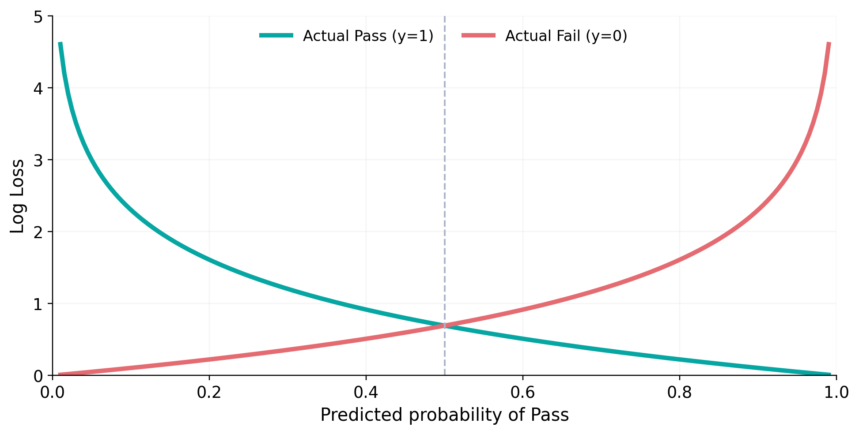
TRAINING
Visualize what Log Loss penalizes
As a probability becomes confidently wrong, the loss rises sharply.
Key idea
If the student passes, assigning p = 0.99 is excellent.
If the student passes, assigning p = 0.01 is very costly.
This is why the model optimizes probabilities, not just the final 0/1 predictions.
LOGISTIC REGRESSION • CLASSROOM GUIDE
18
Notes:
Ask which line represents actual y=1. The turquoise line decreases as p approaches 1.

Slide 20
TRAINING
Calculate average Log Loss for three students
The training objective averages loss across observations.
Actual y
Predicted p
Probability of actual label
Individual loss
1 — Pass
0.8
0.8
0.223
0 — Fail
0.3
0.7
0.357
1 — Pass
0.6
0.6
0.511
Average Log Loss = (0.223 + 0.357 + 0.511) / 3 ≈ 0.364
Goal of model training: find coefficients that make this average loss as small as possible.
LOGISTIC REGRESSION • CLASSROOM GUIDE
19
Notes:
Do not teach multiplication of likelihoods. Directly compute individual losses and their average.

Slide 21
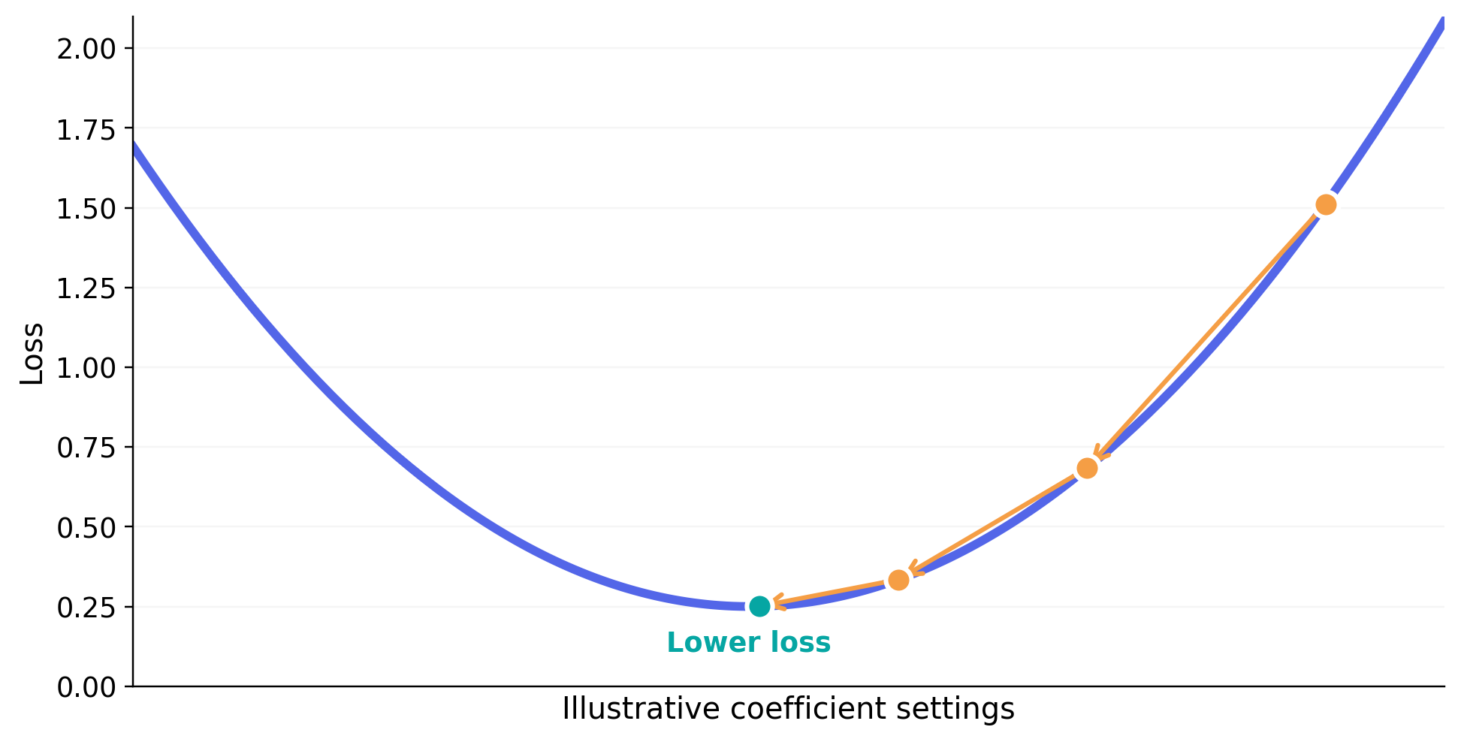
TRAINING
Step 8 — Gradient Descent: the intuition
Think of training as moving downhill toward lower loss.
TRAINING LOOP
1
Choose starting m and c
2
Calculate probabilities
3
Measure Log Loss
4
Adjust m and c
5
Repeat until training stops
The downhill diagram illustrates the idea; actual optimization can involve many coefficients and a more complex surface.
LOGISTIC REGRESSION • CLASSROOM GUIDE
20
Notes:
No derivatives or optimizer names. Describe the goal, repeated corrections, and decreasing training loss.

Slide 22
TRAINING
Training and prediction are different operations
Training learns the parameters; prediction reuses them.
TRAINING • fit(X, y)
PREDICTION • predict(X)
Uses features AND known results.
Calculates probabilities, evaluates loss, and learns coefficients.
Uses new feature values.
Calculates score → probability → final class using learned coefficients.
We do not know the true label of a new case at prediction time.
LOGISTIC REGRESSION • CLASSROOM GUIDE
21
Notes:
Ask: When predicting a new student, do we supply the actual Pass/Fail result? No.

Slide 23
FEATURES
Step 9 — Logistic Regression with two features
Extend the linear score to include study hours and attendance.
TWO INPUTS
WORKED EXAMPLE
z = w₁x₁ + w₂x₂ + c
z = 0.8x₁ + 0.05x₂ − 7
x₁ = Hours studied
x₁ = 5, x₂ = 80
x₂ = Attendance (%)
z = 1 → p ≈ 0.731
Coefficients above are illustrative. With multiple features, each feature contributes to the score.
LOGISTIC REGRESSION • CLASSROOM GUIDE
22
Notes:
Explain that the score simply adds weighted inputs; no need to discuss odds interpretation.

Slide 24
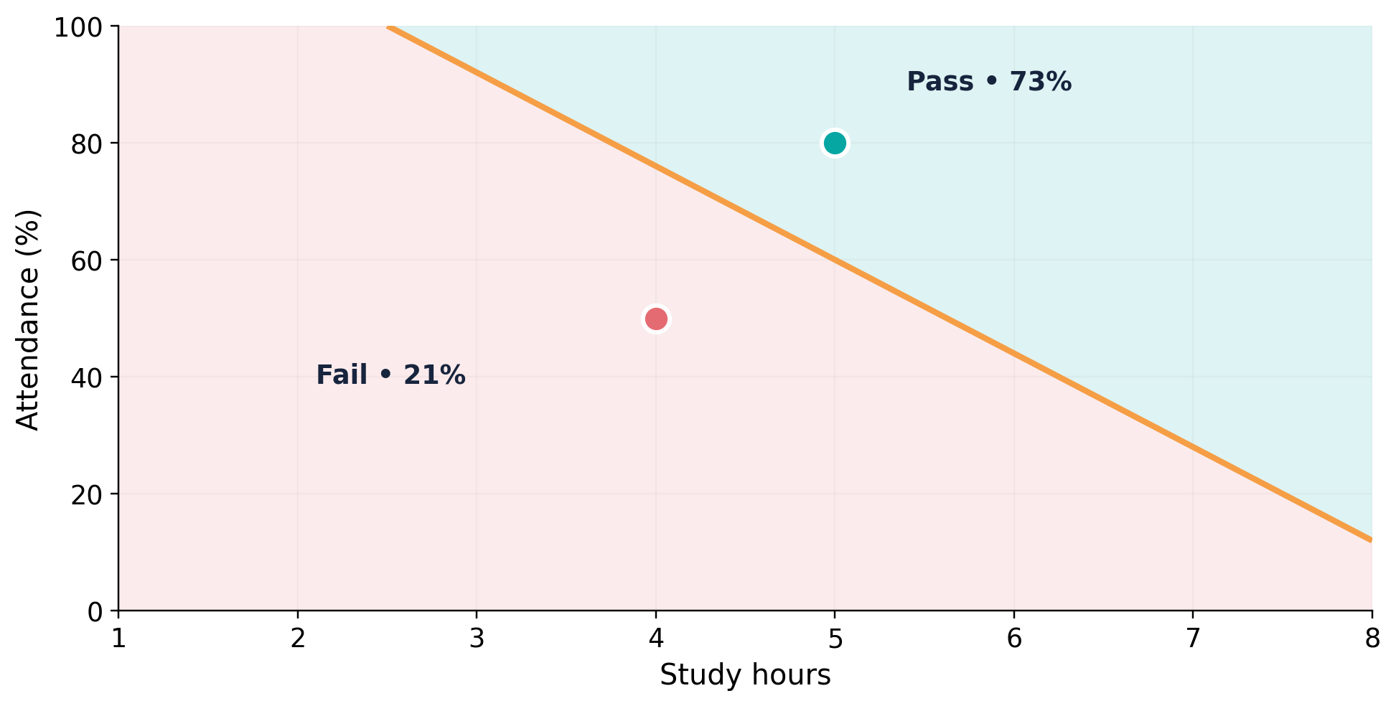
FEATURES
With two features, the boundary becomes a line
A student can cross the decision boundary by changing either feature.
SAME RULE
z = 0 means
p = 0.5
The combination of hours and attendance decides which side of the boundary the student falls on.
Two student points are illustrative: (5 hours, 80%) ≈ 73% Pass; (4 hours, 50%) ≈ 21% Pass.
LOGISTIC REGRESSION • CLASSROOM GUIDE
23
Notes:
Demonstrate the effect of a second feature on the decision. Clarify the axes use different units.

Slide 25
FEATURES
What do the coefficients tell us?
The coefficient sign shows the direction of a feature’s effect on the model score.
Positive coefficient
Negative coefficient
Coefficient near zero
As this feature increases (others held fixed), the model score increases, so P(class 1) increases.
As this feature increases (others held fixed), the model score decreases, so P(class 1) decreases.
A one-unit change in this feature has little effect on the model score, all else fixed.
Coefficients are not “percentage-point probability changes.” They act on the score before Sigmoid.
LOGISTIC REGRESSION • CLASSROOM GUIDE
24
Notes:
Avoid teaching odds or logit terminology here. Focus on direction of probability effect and feature scaling.

Slide 26
EVALUATION
Step 10 — Evaluate classification predictions
A confusion matrix separates correct decisions from the two error types.
PREDICTED CLASS
Fail (0)
Pass (1)
Actual Fail (0)
TN = 16
FP = 4
ILLUSTRATIVE
Correct Fail
Wrong Pass
40 students
Actual Pass (1)
FN = 3
TP = 17
33 correct
7 incorrect
Wrong Fail
Correct Pass
Definitions use Pass as the positive class.
LOGISTIC REGRESSION • CLASSROOM GUIDE
25
Notes:
Ask students to identify which errors might matter more in an application.

Slide 27
EVALUATION
Five metrics students should recognize
Each metric answers a different question.
Metric
Formula
What it asks
Accuracy
(TP + TN) / All
How often is the prediction correct?
Precision
TP / (TP + FP)
When we predict Pass, how often correct?
Recall
TP / (TP + FN)
Of actual Pass cases, how many found?
F1 Score
2 × (P × R) / (P + R)
How balanced are Precision and Recall?
Log Loss
Average probability penalty
How good are the probabilities?
Use ROC-AUC later when introducing ranking performance across decision thresholds.
LOGISTIC REGRESSION • CLASSROOM GUIDE
26
Notes:
Use the previous confusion matrix to compute accuracy 33/40 = 82.5%, precision 17/21 = 81.0%, recall 17/20=85%.

Slide 28
PRACTICAL
Step 11 — Prepare the practical workflow
Use a standard Scikit-learn dataset and reserve test data.
IRIS: VERSICOLOR (0) vs VIRGINICA (1)
01
Load dataset
100 flowers • 2 classes
02
Pick features
Petal length + petal width
03
Train/test split
75 train • 25 test
04
Scale + fit
Pipeline handles both
05
Predict + evaluate
Classes, probabilities, metrics
Fit preprocessing on training data—not on the entire dataset before splitting.
LOGISTIC REGRESSION • CLASSROOM GUIDE
27
Notes:
This is a new real dataset for implementation; the student Pass/Fail data above was for understanding the math.

Slide 29
PRACTICAL
Python 1/3 — Load data and split
Binary Iris classification using two features.
from sklearn.datasets import load_iris
DATA
from sklearn.model_selection import train_test_split
100 samples
iris = load_iris()
mask = iris.target != 0
2 classes
X = iris.data[mask][:, [2, 3]]
y = (iris.target[mask] == 2).astype(int)
2 features
X_train, X_test, y_train, y_test = train_test_split(
stratify keeps class proportions similar in each split.
X, y, test_size=0.25, random_state=42, stratify=y
)
LOGISTIC REGRESSION • CLASSROOM GUIDE
28
Notes:
Explain masking away Iris Setosa; y becomes 1 for Virginica and 0 for Versicolor.

Slide 30
PRACTICAL
Python 2/3 — Train and predict
Scikit-learn learns coefficients when we call fit().
from sklearn.pipeline import Pipeline
THE BIG THREE
from sklearn.preprocessing import StandardScaler
from sklearn.linear_model import LogisticRegression
fit()
Learn from training rows.
model = Pipeline([
("scaler", StandardScaler()),
predict()
("logreg", LogisticRegression(max_iter=1000))
Return class labels.
])
predict_proba()
model.fit(X_train, y_train)
Return class probabilities.
y_pred = model.predict(X_test)
y_prob = model.predict_proba(X_test)[:, 1]
LOGISTIC REGRESSION • CLASSROOM GUIDE
29
Notes:
Avoid optimizer internals. The key message: fit learns parameters; predict returns 0/1; predict_proba returns both class probabilities.

Slide 31
PRACTICAL
Python 3/3 — Evaluate the fitted model
These are actual results from the reproducible Iris example.
from sklearn.metrics import (
ACTUAL TEST RESULTS
accuracy_score, confusion_matrix,
84%
classification_report
)
Accuracy (21 / 25 correct)
print(accuracy_score(y_test, y_pred))
Precision: 90%
print(confusion_matrix(y_test, y_pred))
Recall: 75%
print(classification_report(y_test, y_pred))
Actual held-out confusion matrix: TN=12, FP=1, FN=3, TP=9 (test split uses random_state=42).
LOGISTIC REGRESSION • CLASSROOM GUIDE
30
Notes:
Remind learners these results depend on the exact train/test split and features.

Slide 32
PRACTICAL
Step 12 — Cross-validation checks stability
Instead of trusting one split, repeat validation across several folds.
Fold 1
VALIDATION
TRAIN
TRAIN
TRAIN
TRAIN
Fold 2
TRAIN
VALIDATION
TRAIN
TRAIN
TRAIN
Fold 3
TRAIN
TRAIN
VALIDATION
TRAIN
TRAIN
Fold 4
TRAIN
TRAIN
TRAIN
VALIDATION
TRAIN
Fold 5
TRAIN
TRAIN
TRAIN
TRAIN
VALIDATION
Average the 5 validation scores → cross-validation score
When using a Pipeline, scaling is fitted separately within each training fold, preventing leakage.
LOGISTIC REGRESSION • CLASSROOM GUIDE
31
Notes:
Explain that each row holds out a different fold for validation. The final test set stays untouched until final evaluation.

Slide 33
PRACTICAL
GridSearchCV: compare different model settings
We try multiple C values and select using cross-validation.
C value
Mean CV accuracy
Interpretation
0.01
94.67%
Stronger regularization
0.1
94.67%
1
96.00%
Highest score (tie)
10
96.00%
Highest score (tie)
100
96.00%
Highest score (tie)
Best C = 1 (first tied candidate in this grid) • Best mean CV accuracy = 96.00%
C controls regularization strength: smaller C means stronger regularization. Results use the 75 training rows.
LOGISTIC REGRESSION • CLASSROOM GUIDE
32
Notes:
Distinguish mean CV accuracy on training folds (96%) from held-out test accuracy (84%). More tuning does not guarantee better test accuracy.

Slide 34
PRACTICAL
GridSearchCV: the complete tuning pattern
Pipeline + StratifiedKFold + GridSearchCV
from sklearn.model_selection import GridSearchCV, StratifiedKFold
cv = StratifiedKFold(n_splits=5, shuffle=True, random_state=42)
param_grid = {"logreg__C": [0.01, 0.1, 1, 10, 100]}
grid = GridSearchCV(
model, param_grid=param_grid, cv=cv, scoring="accuracy"
)
grid.fit(X_train, y_train)
print("Best parameters:", grid.best_params_)
print("Best CV score:", grid.best_score_)
print("Test accuracy:", grid.score(X_test, y_test))
The double underscore targets a parameter inside the pipeline step named “logreg”.
LOGISTIC REGRESSION • CLASSROOM GUIDE
33
Notes:
Explain how GridSearchCV evaluates C choices using the folds. Never tune on the final test set.

Slide 35
RECAP
The whole algorithm in four ideas
A clear mental model matters more than memorizing implementation details.
LINEAR SCORE
PROBABILITY
z = mx + c
p = 1 / (1 + e⁻ᶻ)
Combine the input features.
Sigmoid keeps output in 0–1.
LEARNING
CLASSIFICATION
Minimize Log Loss
p ≥ threshold → 1
Find useful m and c from data.
Convert probability into a label.
fit() learns • predict_proba() estimates • predict() classifies
LOGISTIC REGRESSION • CLASSROOM GUIDE
35
Notes:
Ask four questions: What is z? Why Sigmoid? Why Log Loss? What does the threshold do?

Slide 36
THE ONE-SENTENCE TAKEAWAY
Logistic Regression uses a linear score to estimate a probability, learns from Log Loss, and turns the probability into a class.
Next: run the Iris example, inspect probabilities, and tune C with cross-validation.
Notes:
Close with the connection to the previous session: Linear Regression predicts a number; Logistic Regression predicts a probability for classification.

